Slide 1

Group 1- Semester Project
Website Planning organization

Slide 2

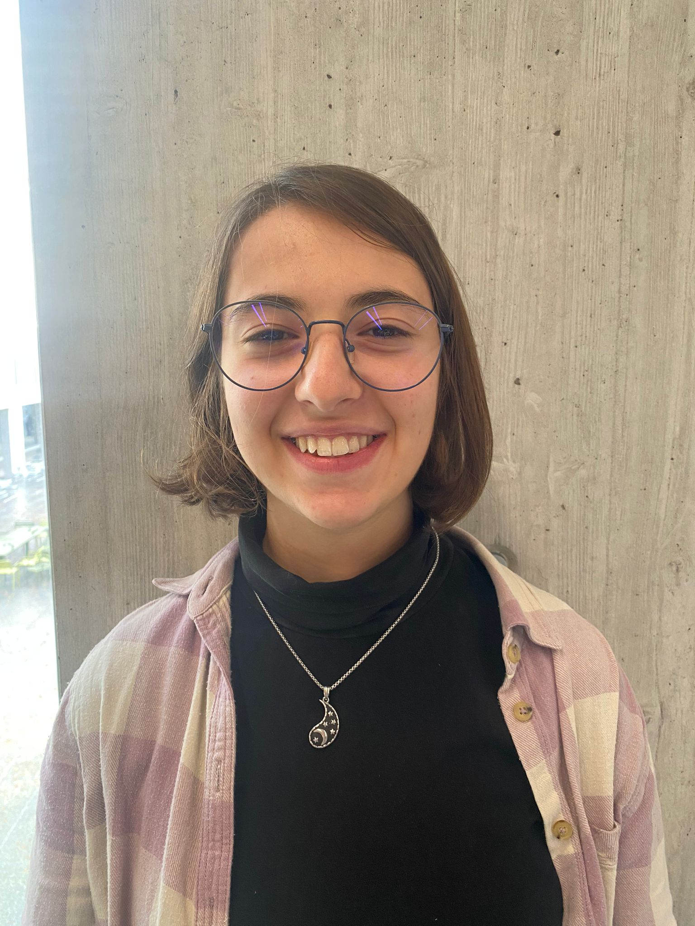
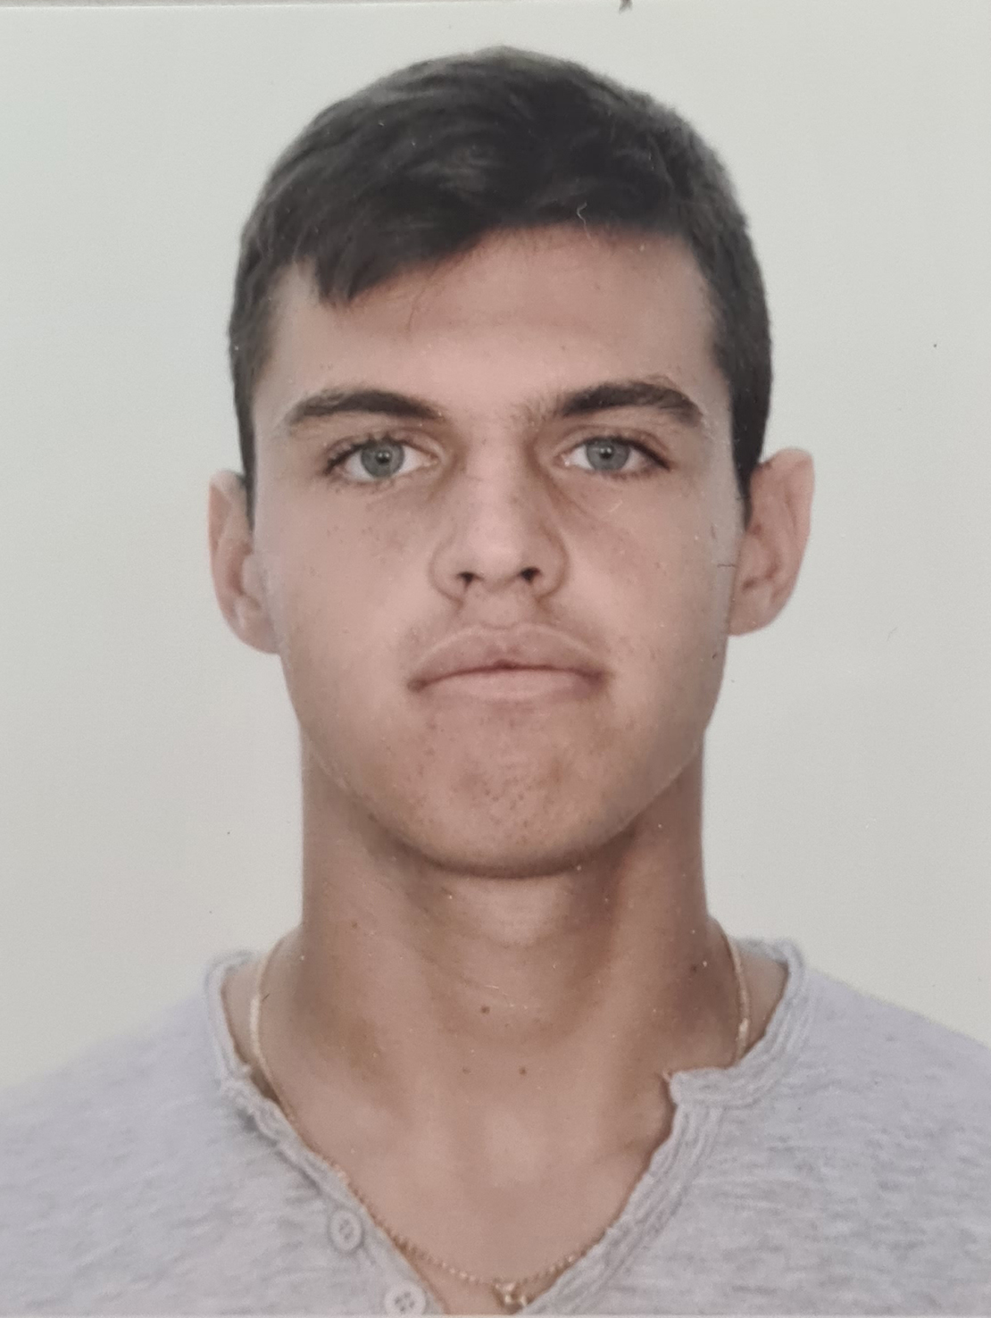



Project Manager
Noah
Alessandra
Simone
Sebastiano
Yohsua
Nicoló
CSS Managers
Git Manager

Slide 3
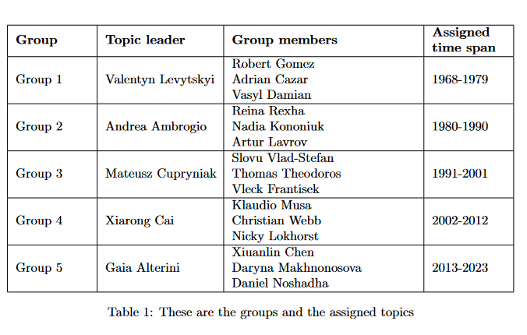
Sub Group Division

Slide 4
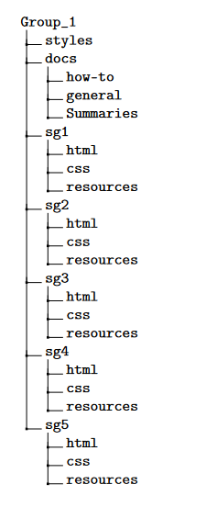
Templates for the whole project
Generale documentation; How to use Git, PowerPoint, Latex, …
SubGroup Directory to storage of they’re part of site
Git Repository

Slide 5
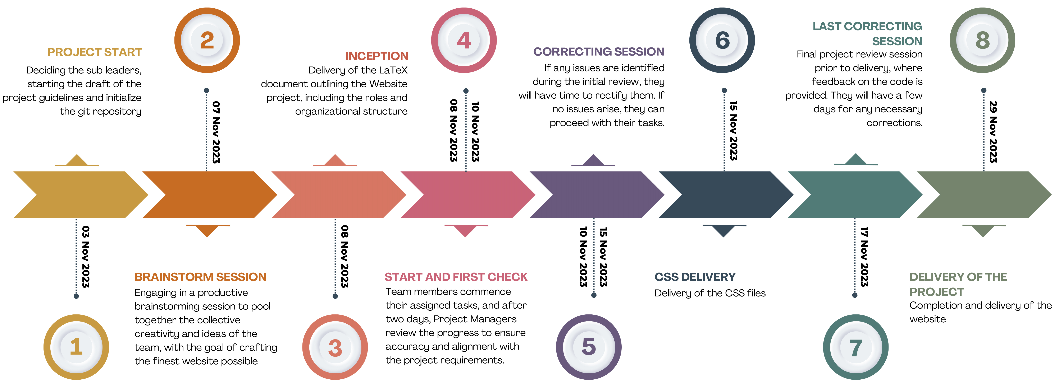
Schedule

